Slide 1



Outlier Detection
What is Outlier Detection?
Why Multi-Variate?
DBSCAN
Isolation Forest
Local Outlier Factor
Application
Q&A
Notes:
Have you ever been traveling abroad, and you cannot use your credit card because it has been frozen? Or when you try to purchase an expensive item and your card gets declined? This is a form of outlier detection. Conrad Kennington, former head of machine learning at Kount a credit card fraud company, said: It is crucial for Data Scientists to understand outlier detection, and not just machine learning.

Slide 2
What Is Outlier Detection
Outlier detection is the identification of rare items, events or observations which deviate significantly from the data
2 Stages:
Outlier Detection: The main data contains outliers
Novelty Detection: The main data contains no outliers but new data might
2 Methods
Univariate: Looking only at 1 variable
Multivariate: Looking at 2 or more variables

Slide 3
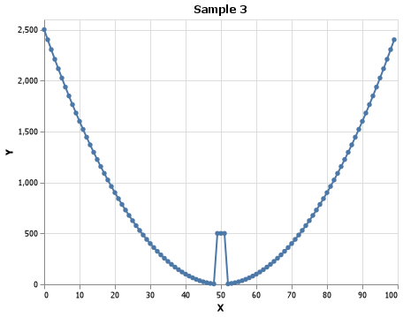
Why Multi-Variate?
Univariate: having one variable in the distribution
Normally used with STD elimination
Multivariate: Having two or more variables in the distribution
Becomes difficult in high dimensional space
Benefit of Sklearn Python package

Slide 4
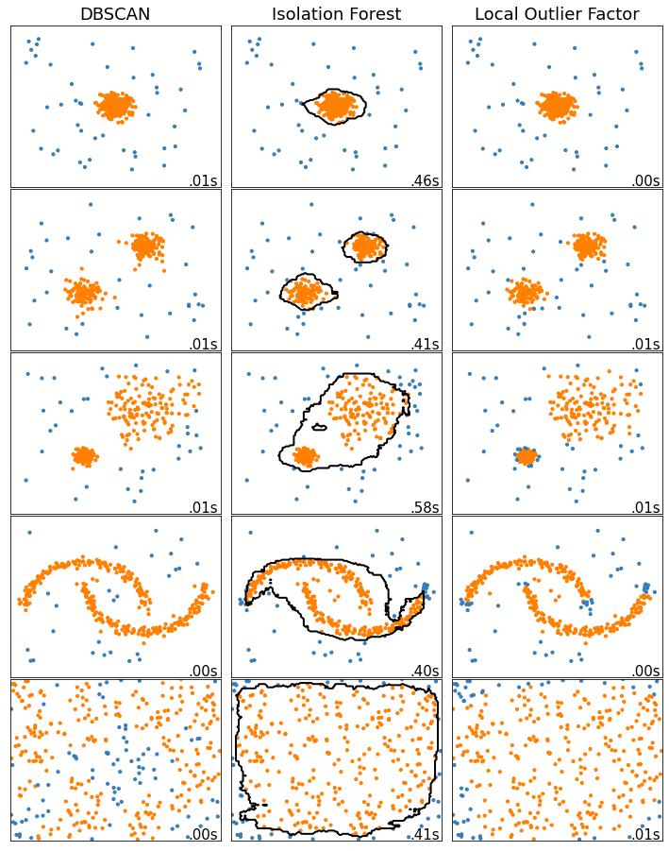

Slide 5
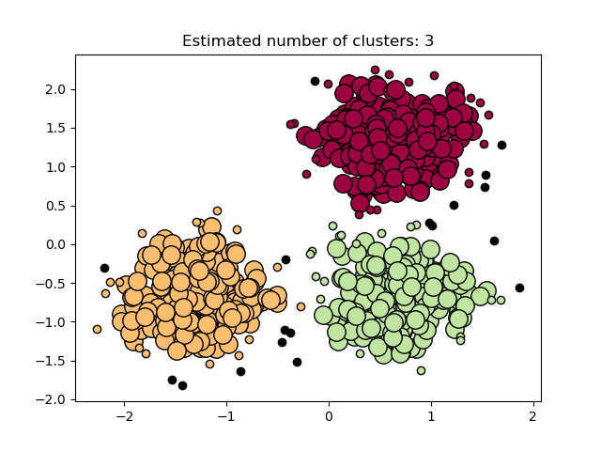
Density Based Spatial Clustering of Applications with Noise
Core Samples of high density
Creates clusters from Core Samples
2 main parameters:
Min_samples: n samples needed to create Core Samples
Eps: Distance
Metric: How distance is measured

Slide 6
DBSCAN
Core Samples of high density
Creates clusters from Core Samples
3 main parameters:
Min_samples: n samples needed to create Core Samples
Eps: Distance
Metric: How distance is measured

Slide 7
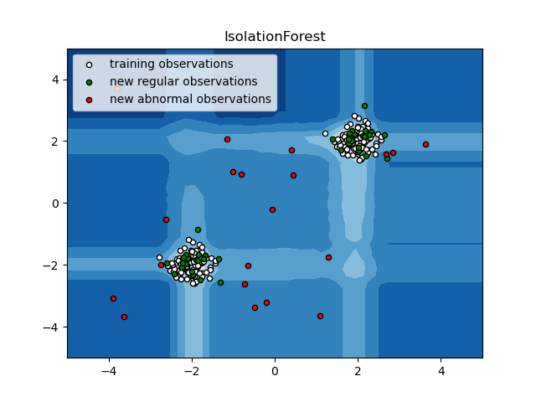
Isolation Forest
Creates partitions between min and max values
Can be represented in a ‘tree’ structure
1 main parameter:
Contamination: The ‘percent’ of contamination within the data
This will also remove x percent of rows

Slide 8
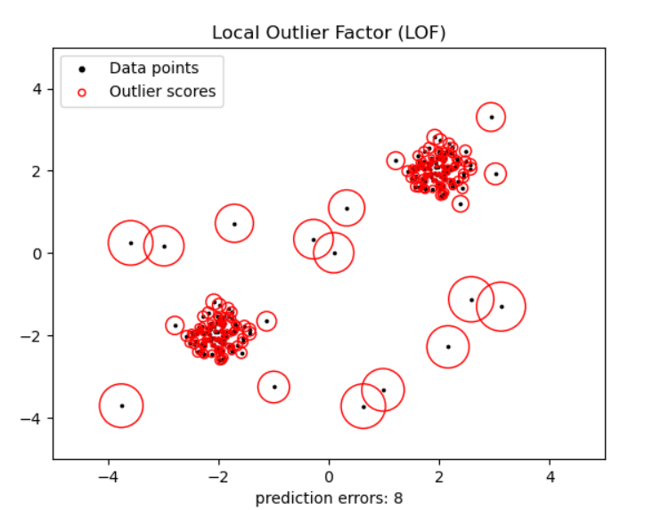
Local Outlier Factor
Focuses on Anomaly Score more than classification
Based on contamination parameter, will create a threshold
3 main parameters;
N_neighbors: number of points for a dense cluster
Metric: how distance is measured
Contamination: Percent contaminated

Slide 9
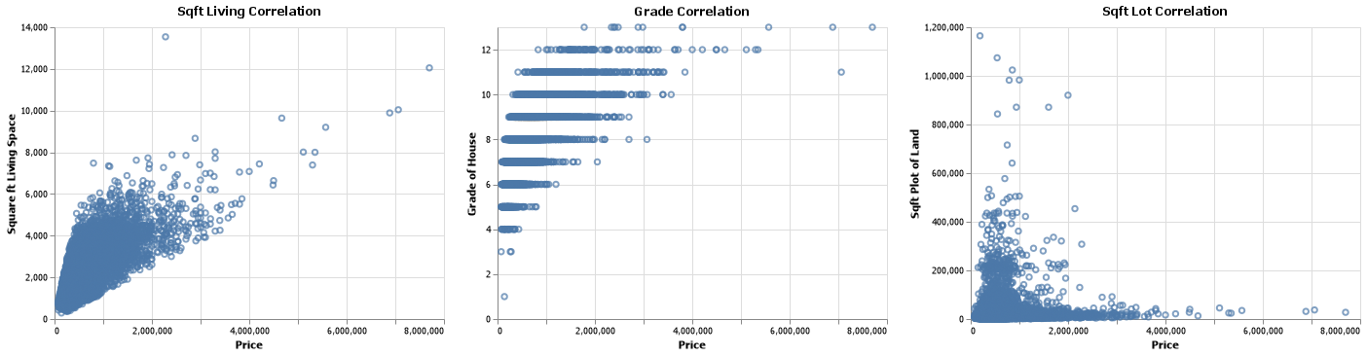
Base RMSE: $220,000
Application
Notes:
RMSE is a measurement of how far the points are from the prediction, on average

Slide 10
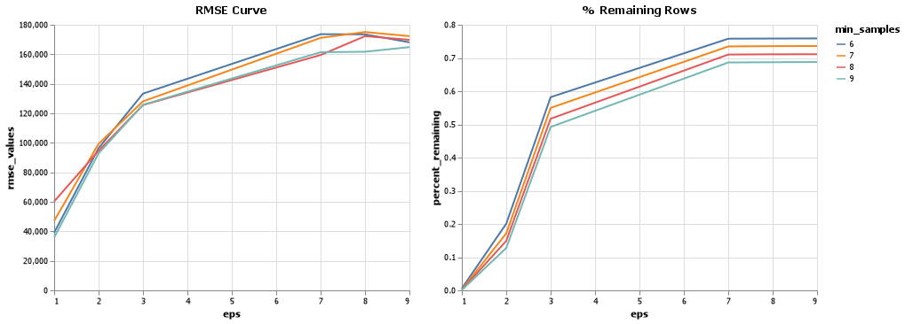
DBSCAN eps = 9 | min_samples = 6

Slide 11
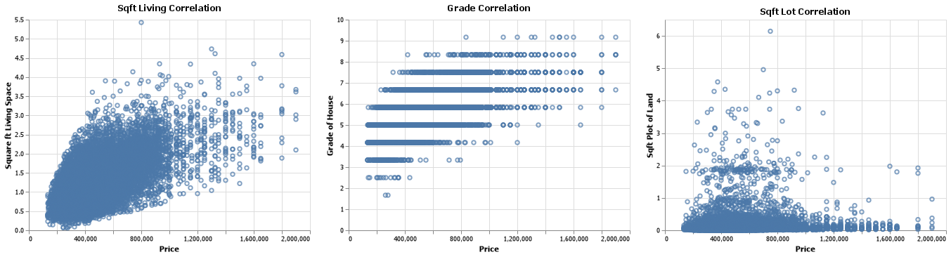
Resulting Data

Slide 12
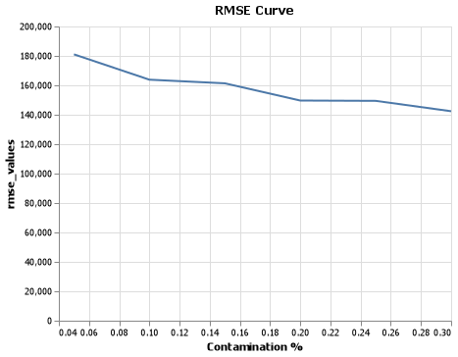
Isolation Forest contamination = .15 Decrease of $70,000

Slide 13
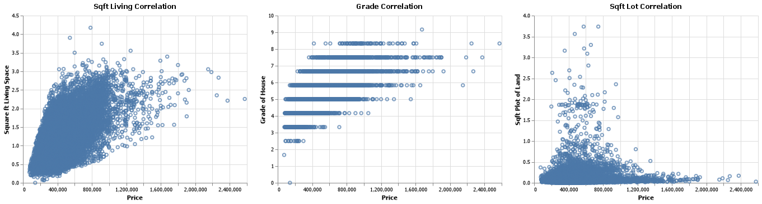
Resulting Data

Slide 14
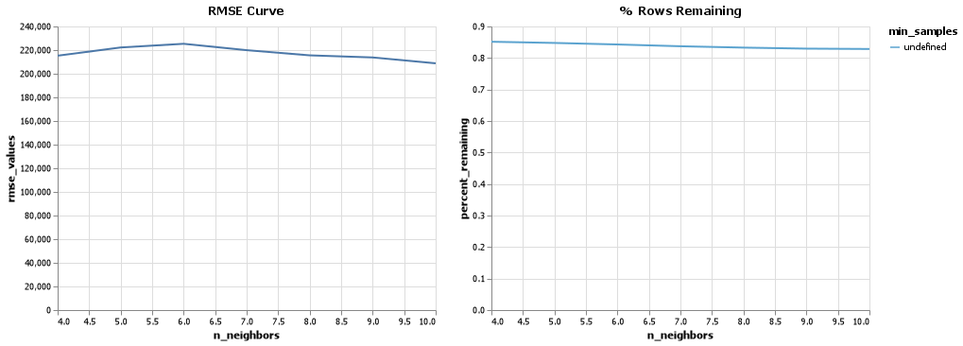
Local Outlier Factor n_neighbors = 2 | metric = ‘Euclidean’ | contamination = ‘Auto’

Slide 15
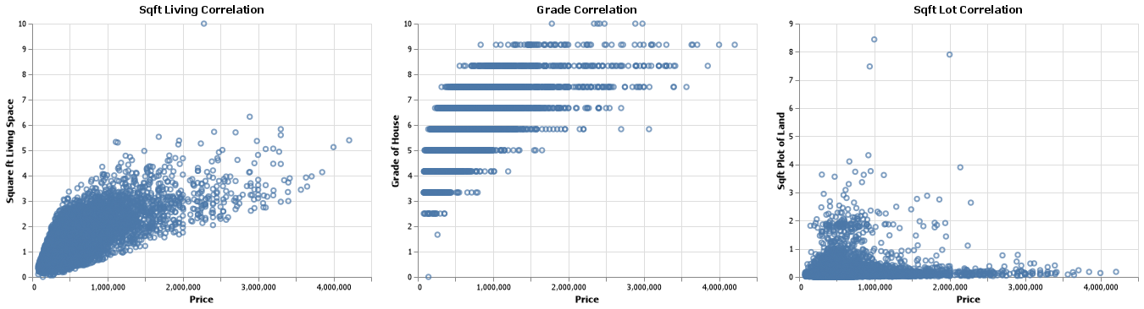
Resulting Data

Slide 16
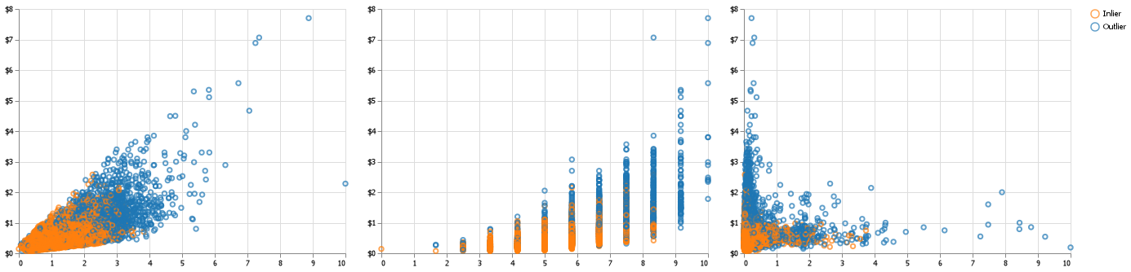

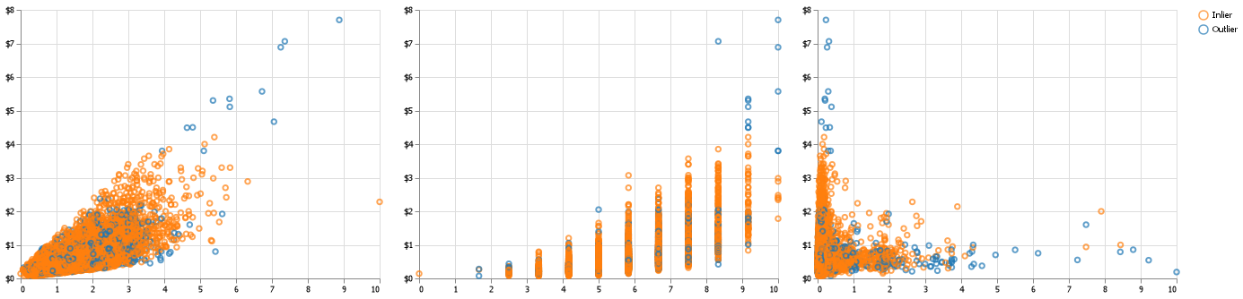
SQFT_LIVING GRADE SQFT_LOT
DBSCAN
Isolation Forest
Local Outlier Factor
PRICE
PRICE
PRICE

Slide 17
Thank you Q&A

